Slide 1
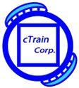
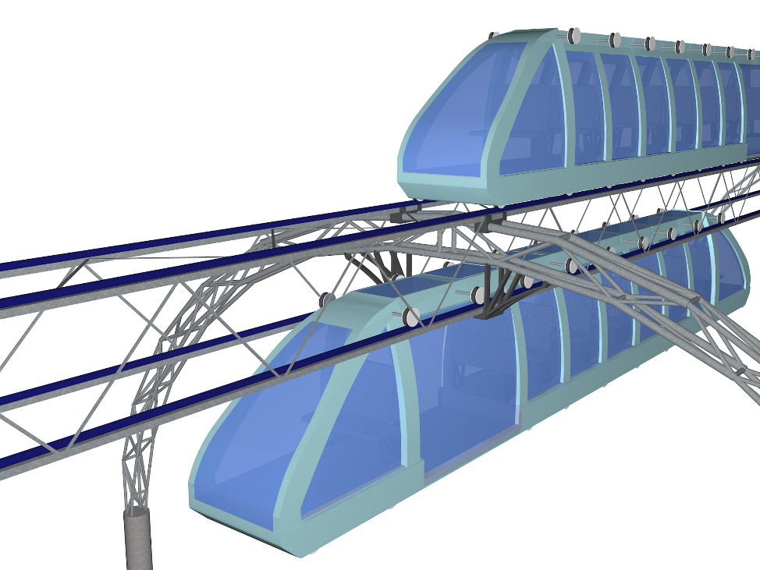
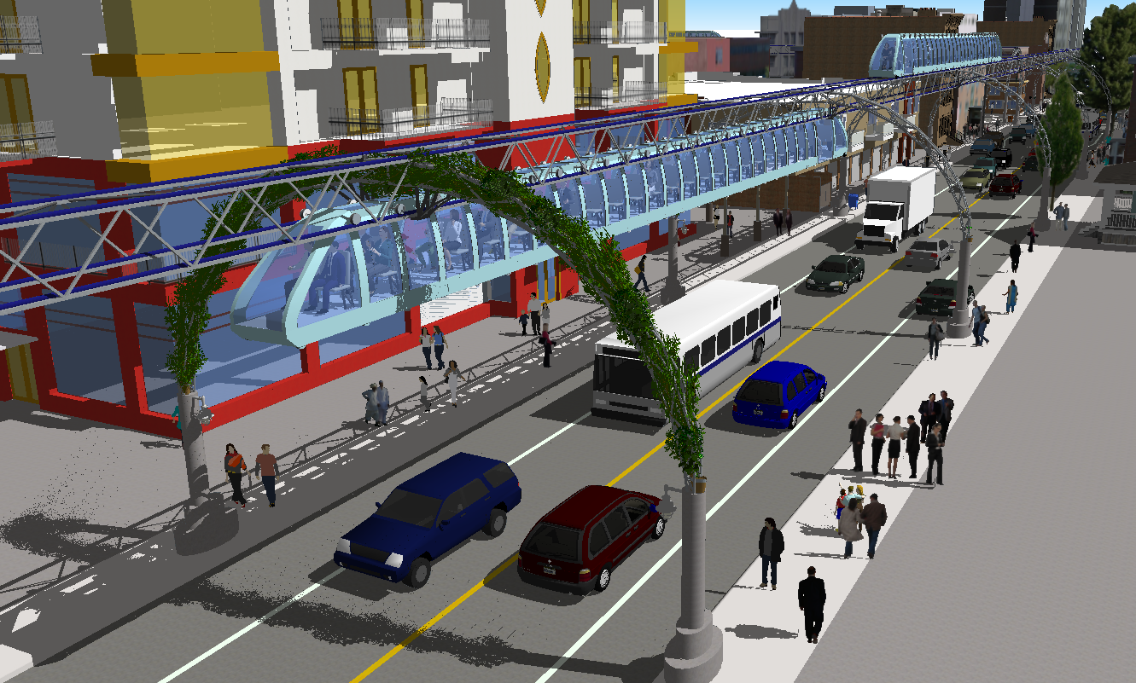
Mini Elevated cTrains
A Comprehensive Solution to Mass Transit
Ashwani Kumar, PhD, Singapore-MIT alliance
General Manager / CRIS, Indian Ministry of Railways
Emil Jacob, MDS Design for Human Health, Boston Architectural College
President, Designer
emil.jacob@ctrain.net

Slide 2
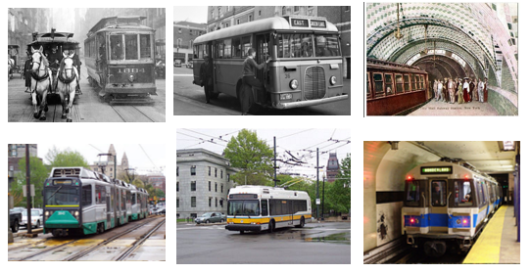
Mini Elevated cTrain
Mass transit lacks advancements from early inception days
Limited to no progress in most essential areas
speed
frequency
comfort
cost
accessibility – last-mile
privacy
The only significant progress made:
Air conditioning
Time Tracking apps

Slide 3
Mini Elevated cTrain
In order to provide a comprehensive solution mass transit needs to meet the following needs:
Mass transit by levels:
Below ground
At ground level
Above ground level
ELEVATED MASS TRANSIT – optimal model for a comprehensive solution
1. Accessibility from within an acceptable walking distance
2. Frequency at a reasonable wait times.
3. Speed at acceptable levels
4. Comfort and privacy.
5. Cost level acceptable to passenger.
6. Emissions and noise free mass transit.

Slide 4
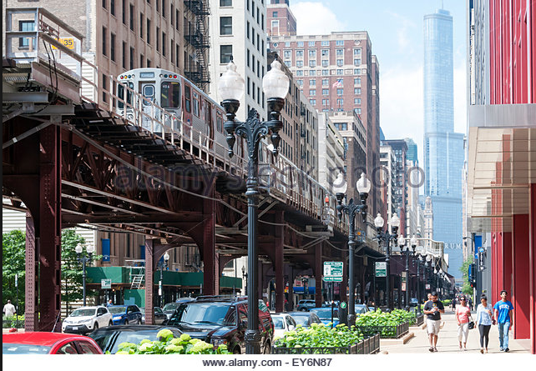
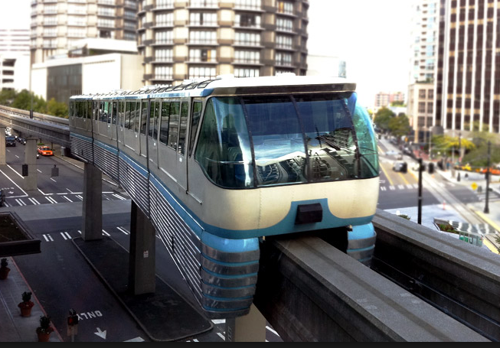
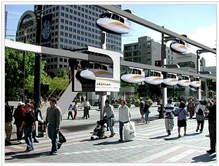
Mini Elevated cTrain
Why has ELEVATED MASS TRANSIT failed to provide a comprehensive solution to date?
Elevated trains present problems:
Visual blight
Noise
Cleanliness
Chicago L Train
Monorails provide an improvement but are limited to areas with sufficiently wide open space.
www.seattlemonorail.com
Personal Rapid Transit are less limited by available open space.
Visual blight - require a large number of pods to meet demand in order to provide a comprehensive solution
wikipedia.org/wiki/SkyTran

Slide 5

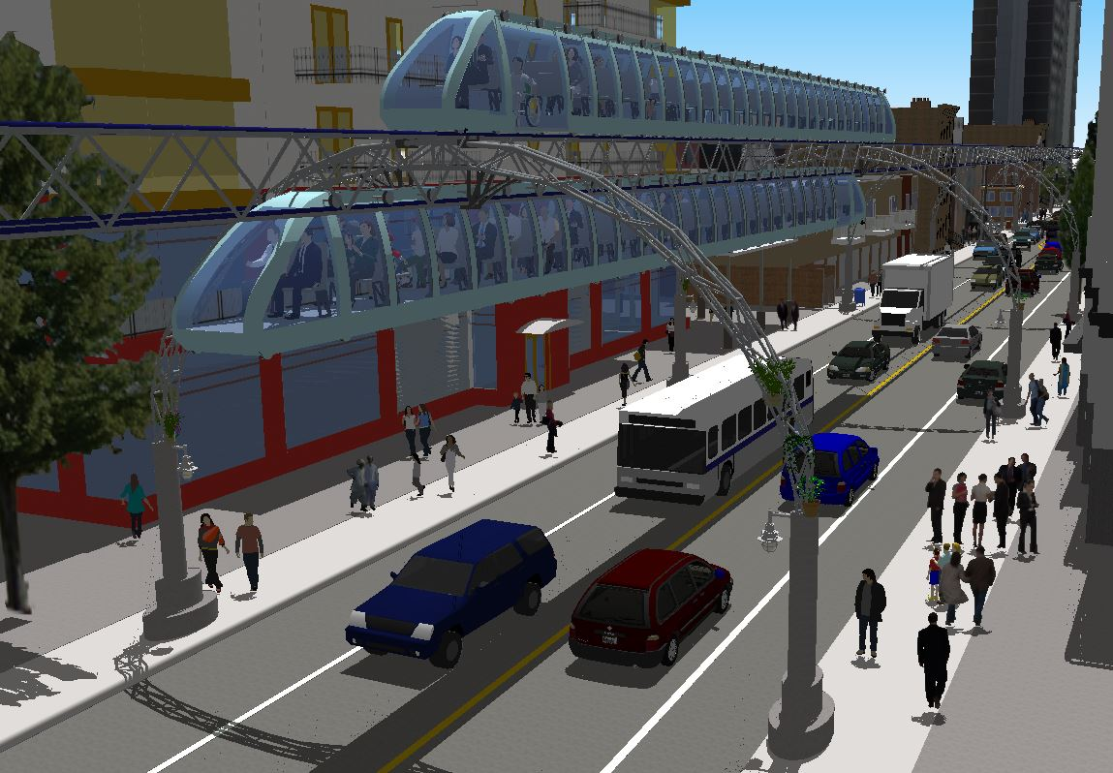
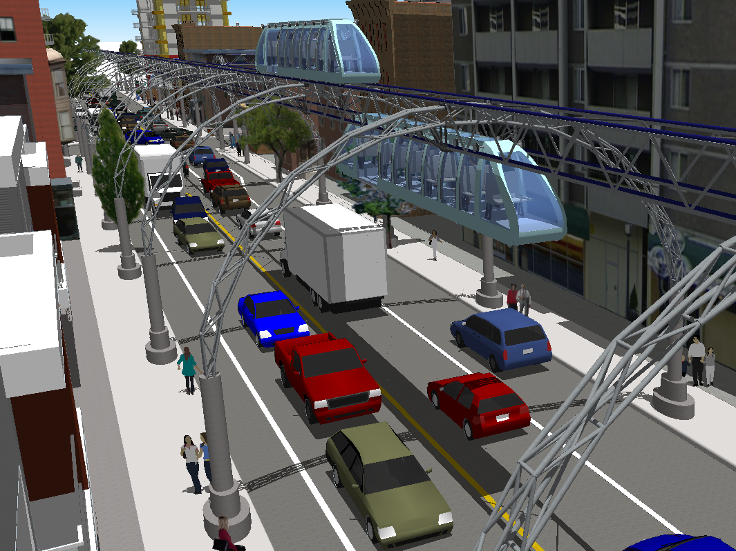
Proposed design
cTrain concept – elevated mini trains
Mini Elevated cTrain
Travel both above and below the tracks
Keeps the cTrain at maximum distance away from built environment
Use of arches as supporting structures
Optimal for centered support – i.e. travel above and below tracks. And for minimizing visual impact of supporting structures

Slide 6
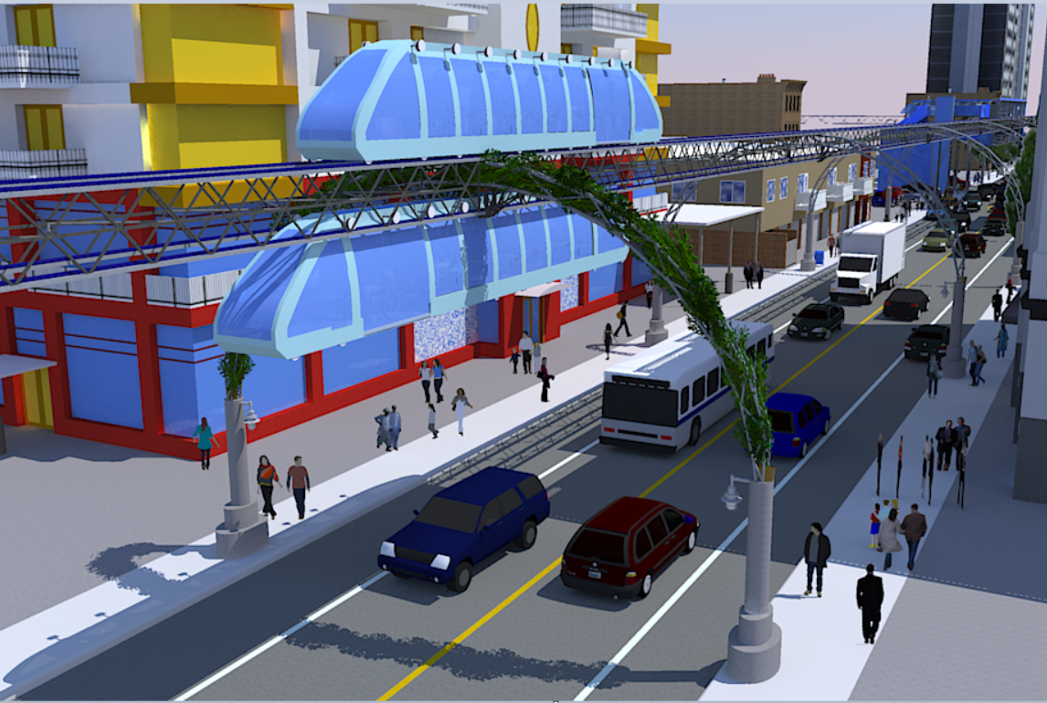
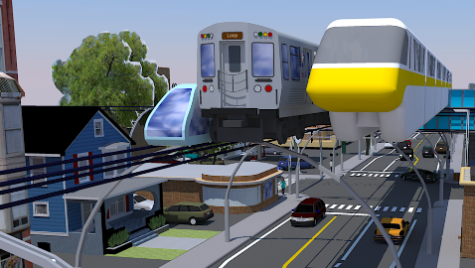
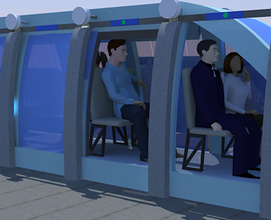
Proposed design
Mini Elevated cTrain
Minimal height + Minimal width
minimal weight per train
Minimal thickness of tracks and supporting structures (& low cost)
minimally visible supporting structures
1.7m
1.5m
Comparison in size versus monorail and elevated train
Seating room only

Slide 7
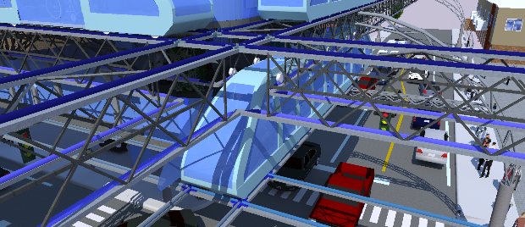
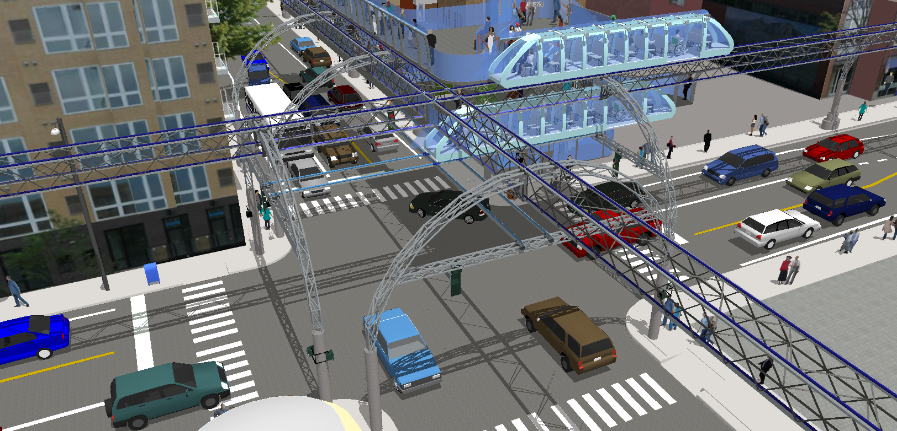
How are the wheels going to cross intersecting tracks?
Mini Elevated cTrain

Slide 8
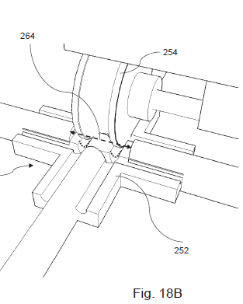
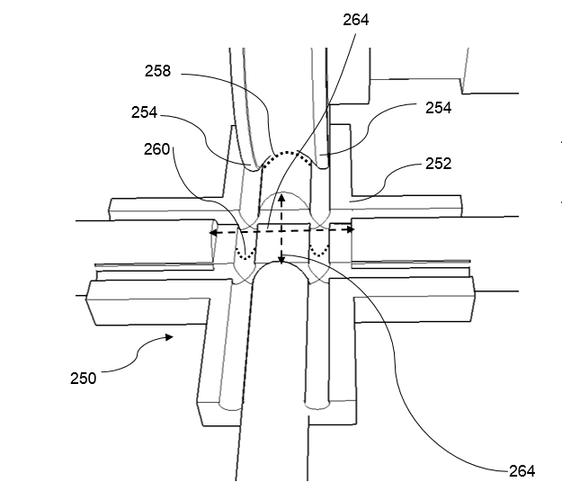
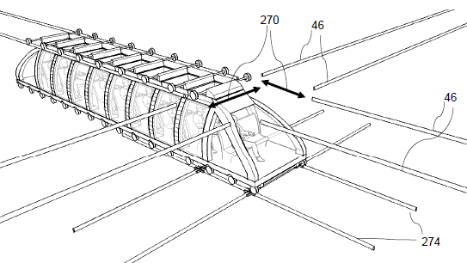
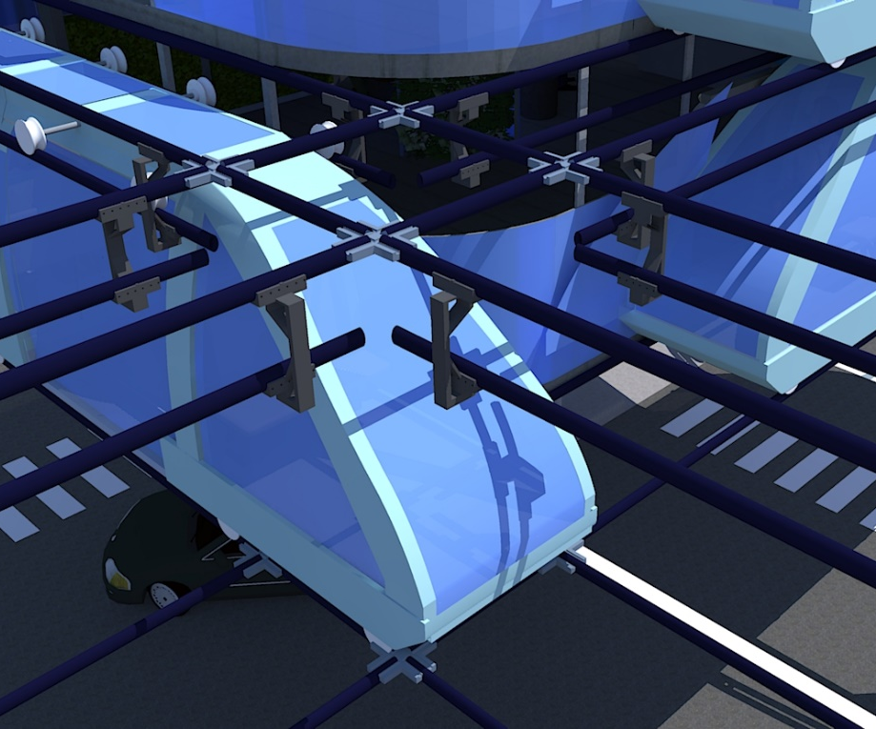
How are the wheels going to cross intersecting tracks?
Mini Elevated cTrain
Crossing of upper wheels (over lower tracks)
Using transitional – crossing tracks, for support when crossing opening 270 (or 46)

Slide 9
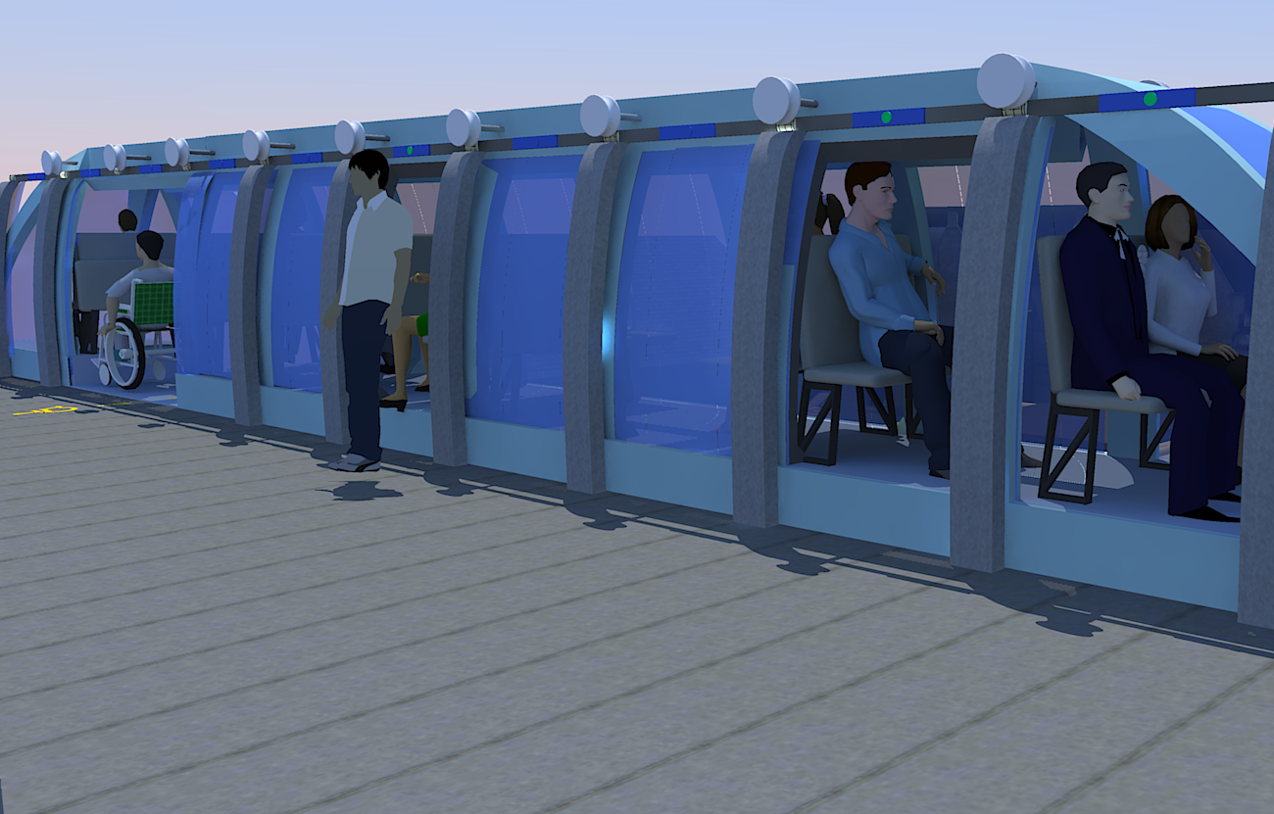
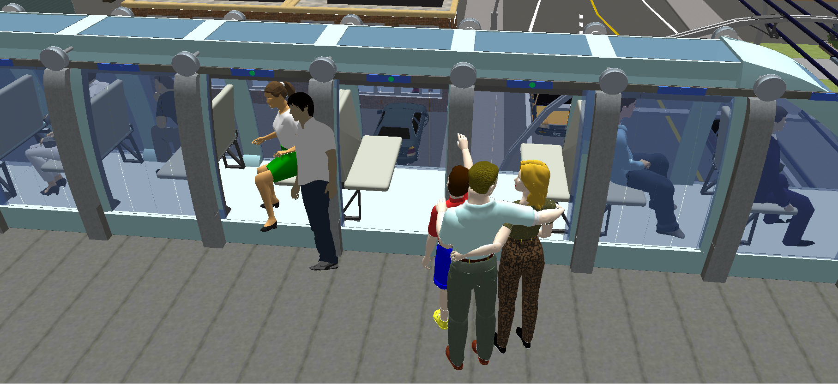
Privacy
Mini Elevated cTrain
Each seat is designated for one passenger but can accommodate two people (if they so choose)
Wheelchair access on every train
Section with at least two seats facing each other to enable up to 4 adults to sit together
CAPACITY: by providing cTrain extensive coverage and high frequency, spread over every main street the system can meet the demand

Slide 10
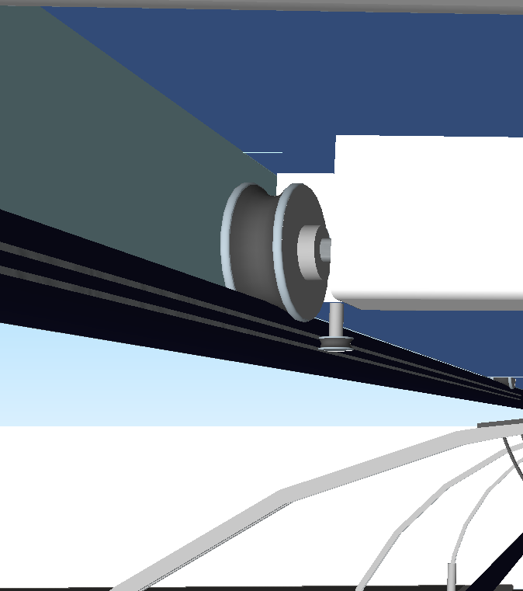
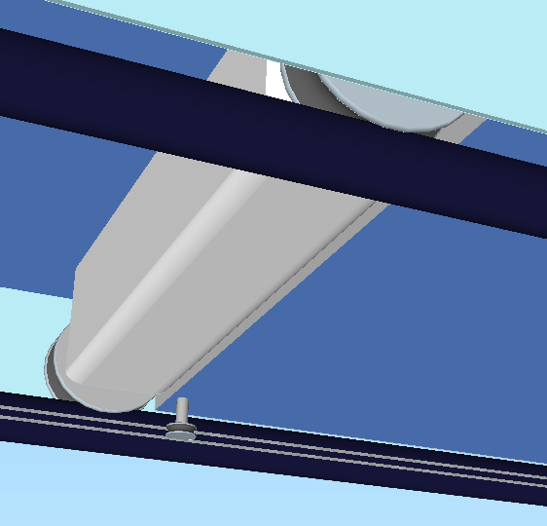
Mini Elevated cTrain
What are the guarantees against derailment?
Each wheel will have at least one safety wheel running horizontally along grooves within the rails positioned to protect against derailment
Expected noise levels
The interior of the wheels has rubber covering.
With optimal shock absorbing technology the expected audible noise is expected to be less than the noise from an electric car on the street.

Slide 11
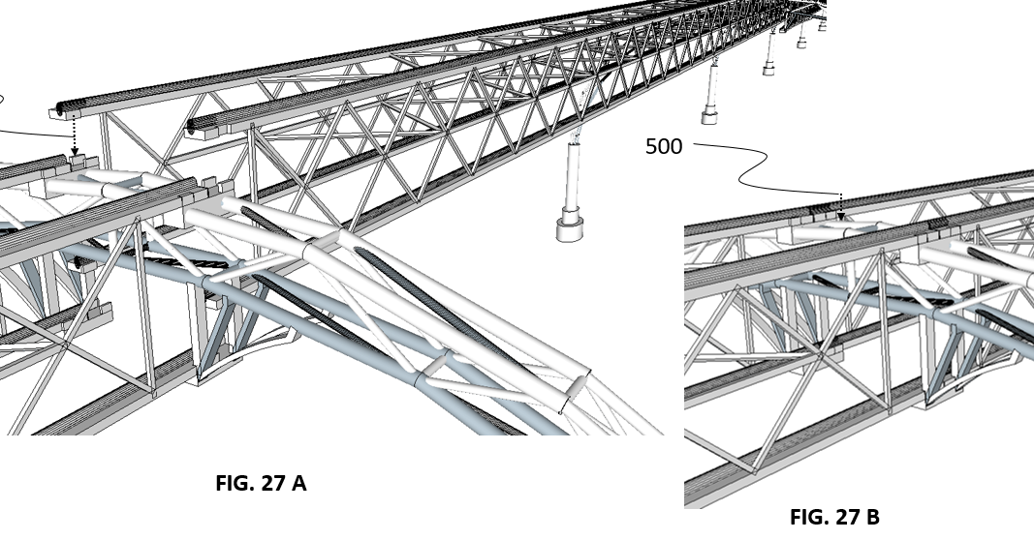
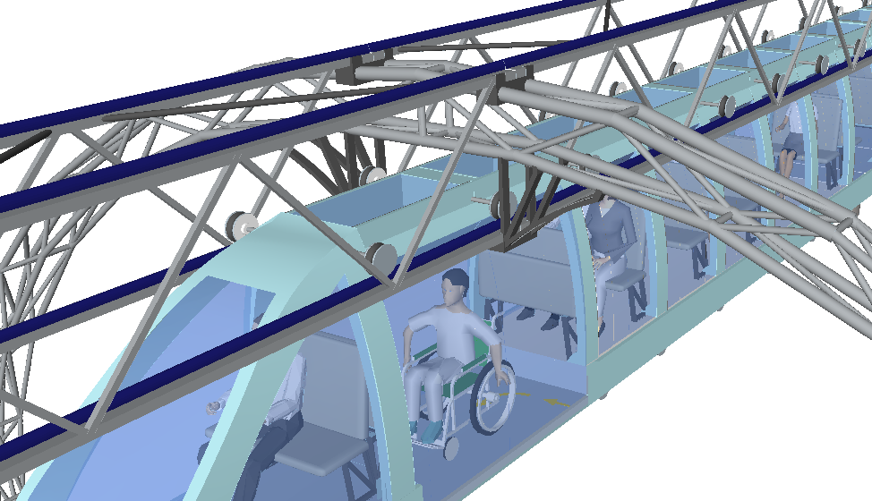
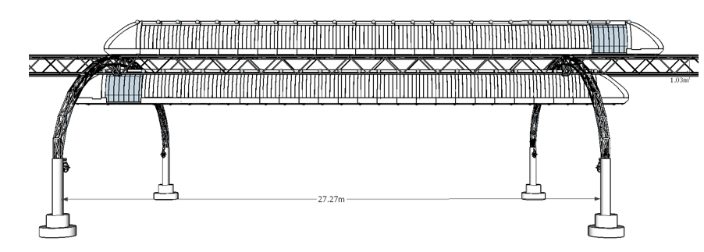
Proposed – structural design
Efficient modular deployment and assembly
Mini Elevated cTrain

Slide 12
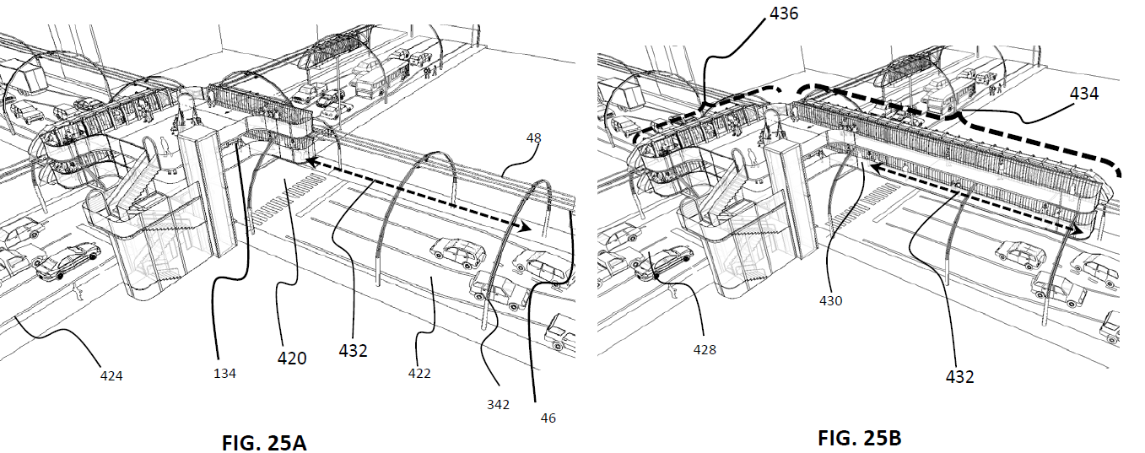
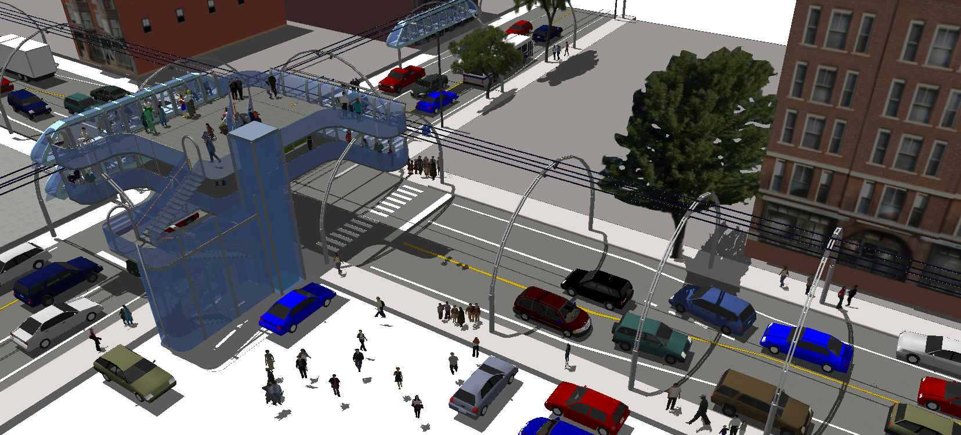
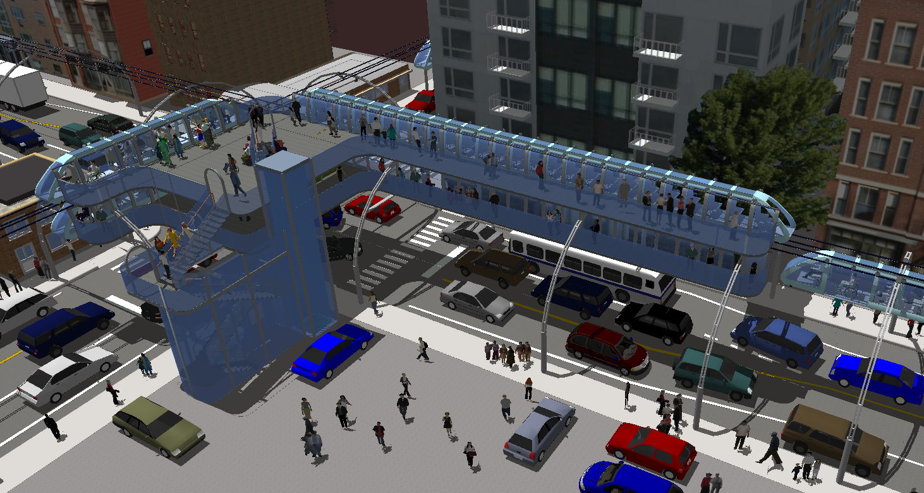
Stations - variable capacity
Flexibility to expand stations and trains length – use of modular elements.
If demand increases on a specific route capacity can be increased flexibly
Mini Elevated cTrain

Slide 13

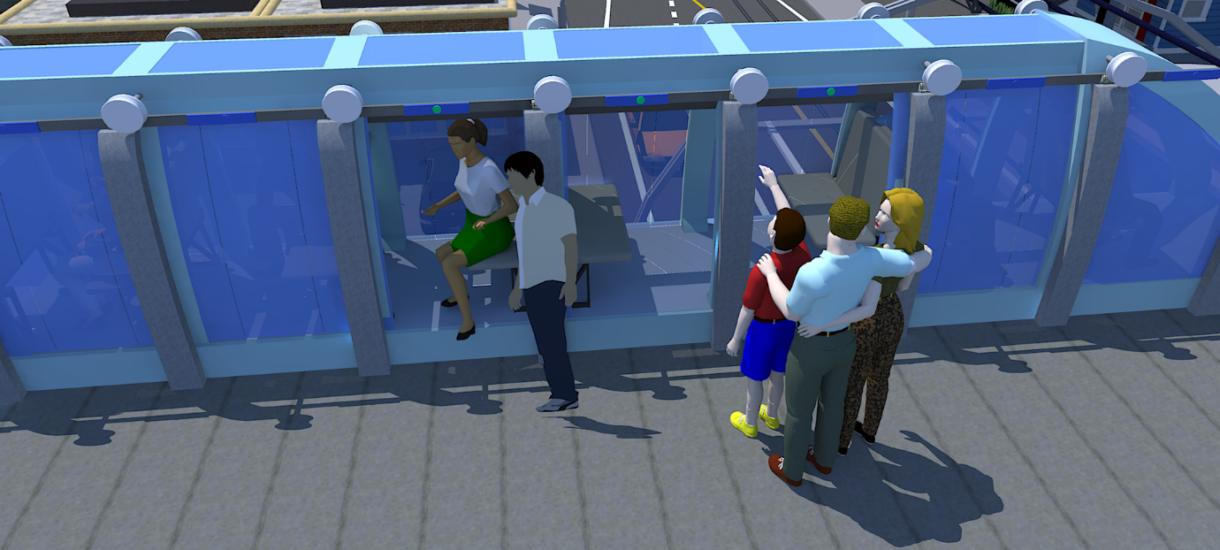
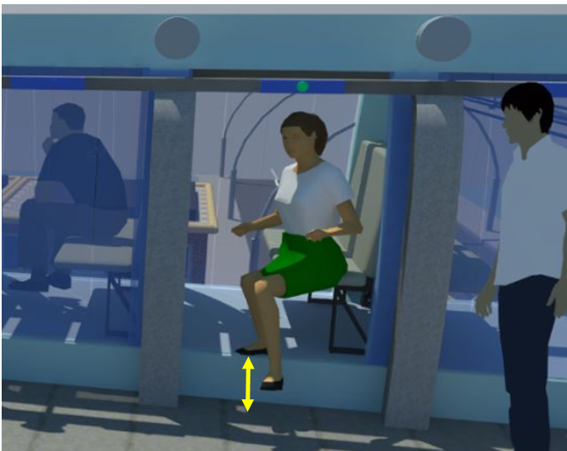
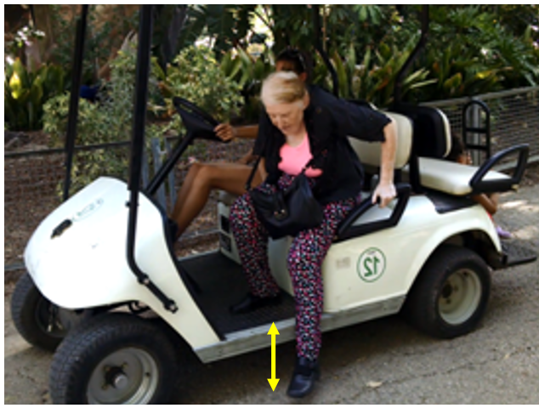
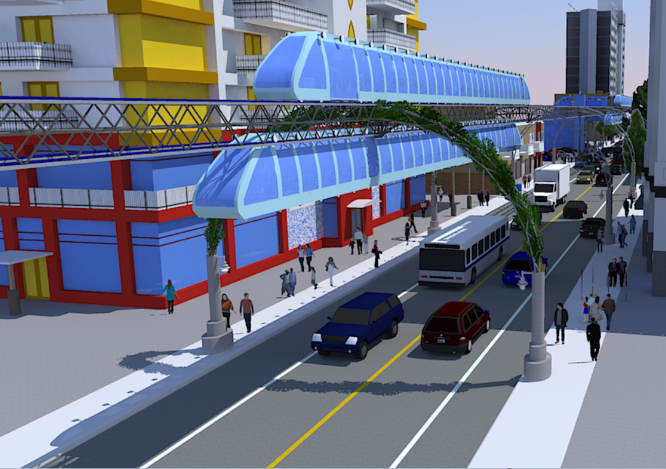
Evergreen arches – for every alternate arch
- ambiance / minimize visual impact on the urban landscape
Mini Elevated cTrain
Variable Capacity
Privacy
Minimal stopping times at stations – OPTIMAL CIRCULATION
Minimal stopping times at stations
Each seat is designated for one passenger but can accommodate two people (if they so choose)
The design can have as few as 10 rows of two seats and over 100 rows of two seats
Each row requires approx. 1 meter.
At 100 rows (i.e. 200 seats) at two trains per minute – capacity up to 24k passengers per hour
Image below shows examples of 25 and 10 rows
Quick and easy access – same as when accessing and exiting an SUV
Passengers wait at doors with green lights (open seats)
3 seconds needed for entry and 3 seconds for exist
Quick and easy access – same as when accessing and exiting an SUV – to reduce the time required to stand up and sit down
Section with at least two seats facing each other to enable up to four people to sit together
CAPACITY: by providing cTrain extensive coverage and high frequency, spread over every main street the system can meet the demand
1876

Slide 14
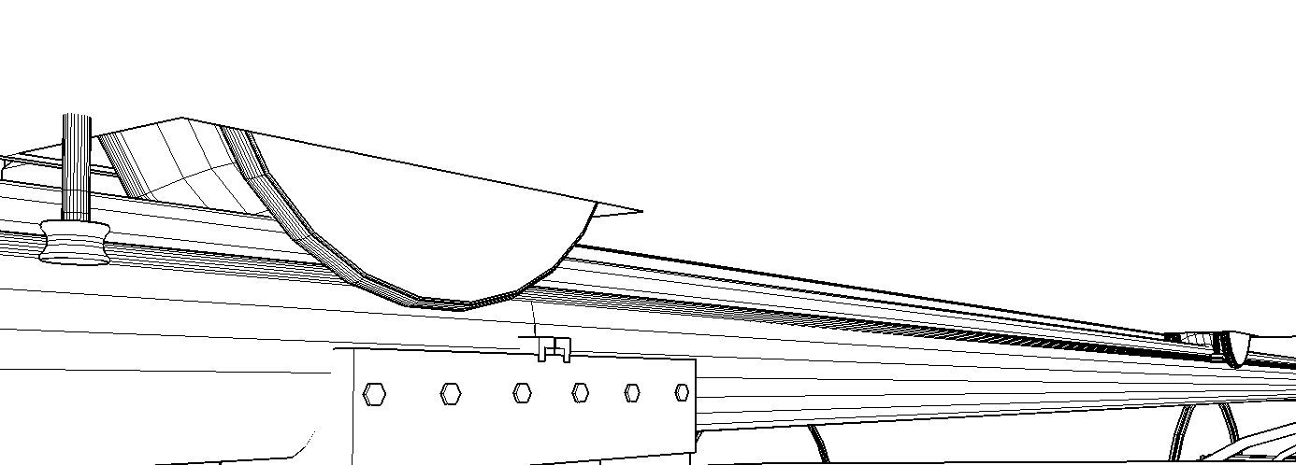
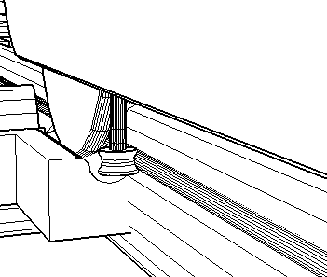
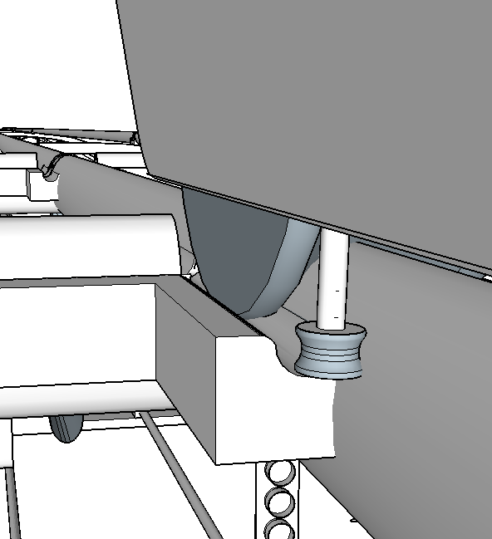
Safety
Mini Elevated cTrain
Horizontal wheels – stabilizers, small enough to fit through crossing module
64
340
252
340
64
FIG. 19D
50
FIG. 19C

Slide 15
Mini Elevated cTrain
Minimal stopping times at stations – OPTIMAL CIRCULATION
Quick and easy access – same as when accessing and exiting an SUV
3 seconds needed for entry and 3 seconds for exist
Passengers wait at doors with green lights (upcoming open seats)

Slide 16
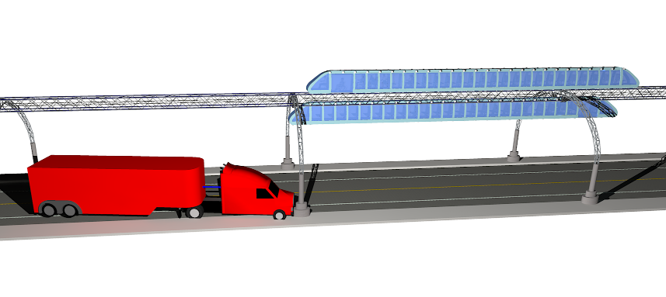
Mini Elevated cTrain
Safety - in case of collision against supporting concrete poles

Slide 17
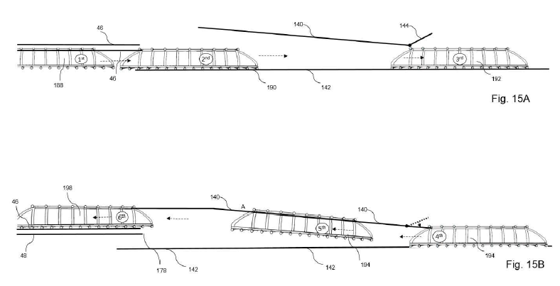
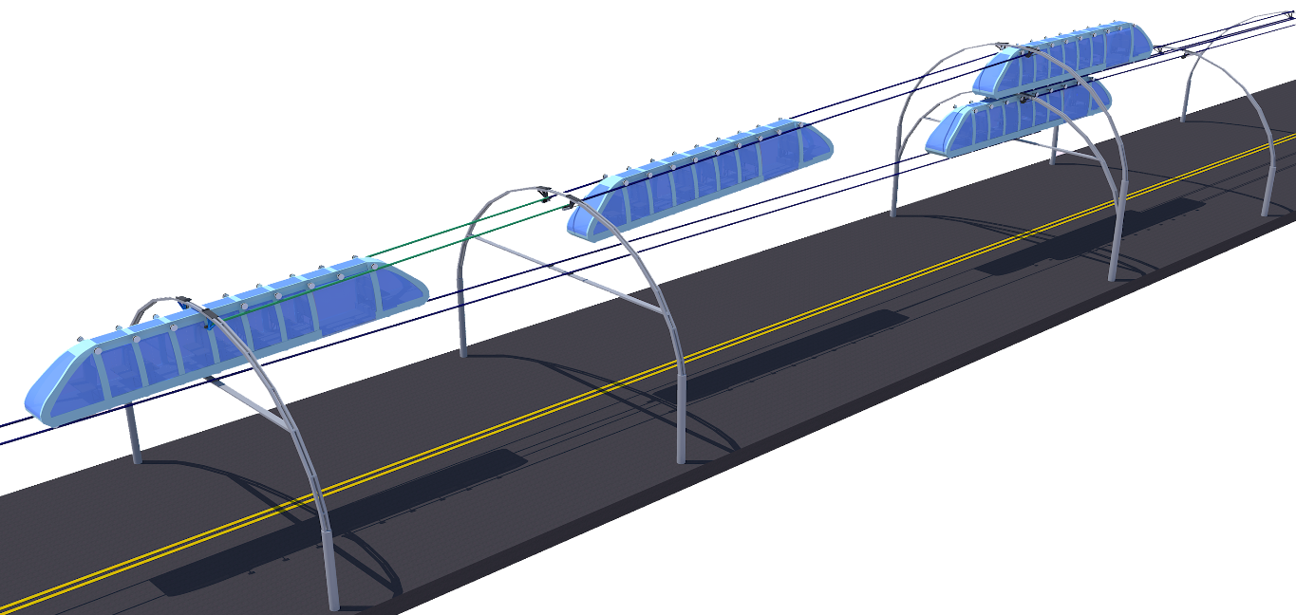
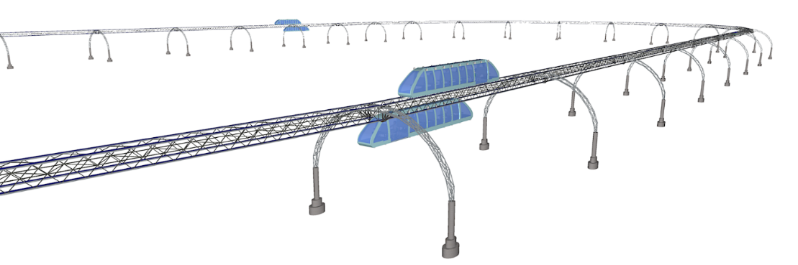
Mini Elevated cTrain
Switching direction - from travel above the tracks to travel below the tracks
Switching feature not needed for routes that are in a loop.

Slide 18
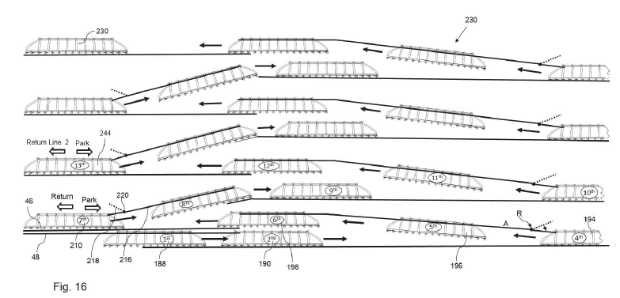
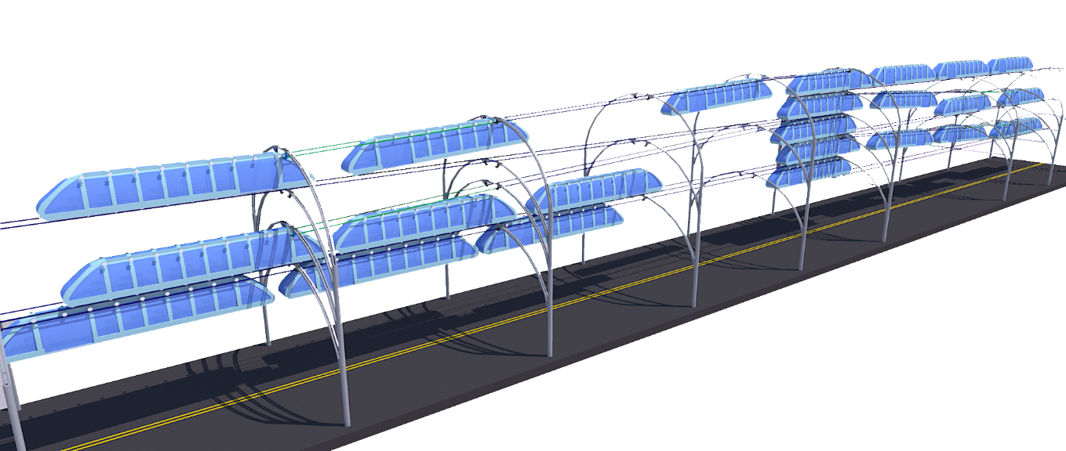
Mini Elevated cTrain
VERTICAL DEPOTS using the same principle: switching between upper and lower tracks

Slide 19
Evergreen arches – for every alternate arch
- ambiance / minimize visual impact on the urban landscape
Mini Elevated cTrain
1876

Slide 20
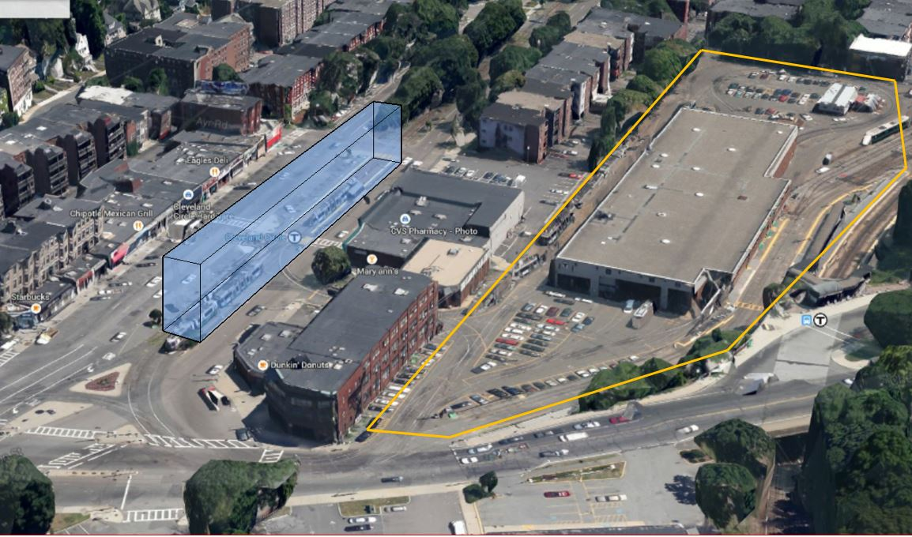

Value Proposition
Mini Elevated cTrain
Vertical depots - free up valuable real estate
Depots can be built above the tracks (blue structure) and can go up multiple stories.
Example: streetcars depot at Cleveland Circle in Brookline, MA, USE; yellow line shows the land taken up by the depot.

Slide 21
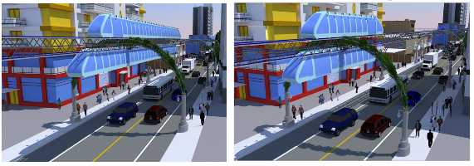
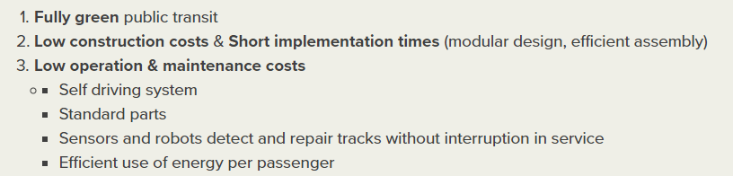
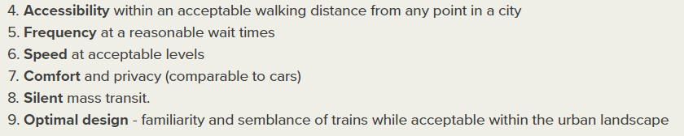
Mini Elevated cTrain
Value Proposition

Slide 22
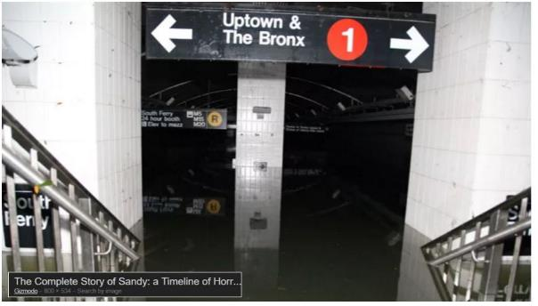
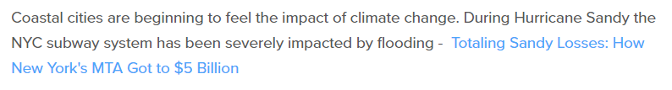
Value Proposition
Mini Elevated cTrain
Preparing for sea level rise

Slide 23
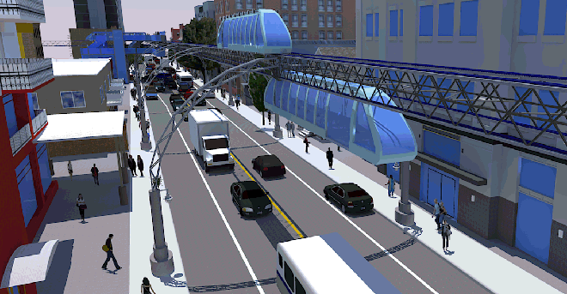
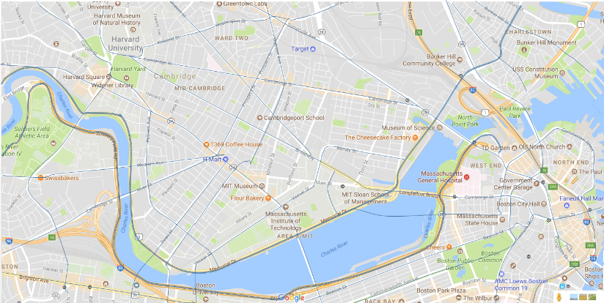
Mini Elevated cTrain
Value Proposition
Providing automated cTrain service over every major street can replace the entire mass transit system in a city such as Boston
Implementation cost of approx. $2b
Annual budget of MBTA - $2b

Slide 24
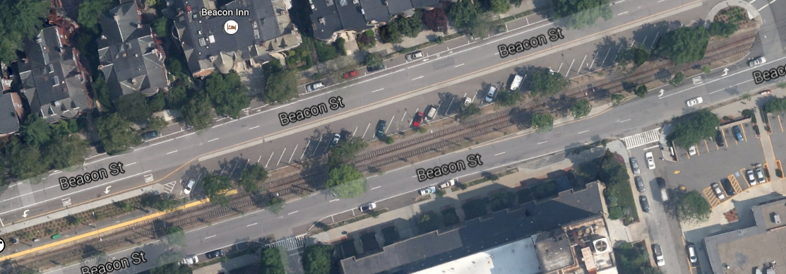


Mini Elevated cTrain
Revenues to the state and the city – Replacing streetcars with cTrain would free thousands of parking spaces in high demand in Boston and Brookline

Slide 25

Mini Elevated cTrain
Space needed for a station at an intersection of two lines
Example of street with two lanes in each direction
Station captures approximately a quarter of the overhead space in the intersection
Ground level space only requires the surface for approximately two parking spaces
Stations at non intersecting lines are significantly smaller

Slide 26


Wheelchair access
Mini Elevated cTrain
Each cTrain has a dedicated wheelchair space
Folding seats can be used as regular seating
Stations include elevator with wheelchair access.

Slide 27

Wheelchair access
Mini Elevated cTrain
Wheel chair access via elevator

Slide 28
Exponential benefits
Worker productivity – less stress, less time wasted in traffic less financial strain from car costs etc.
Employment – greater access to and from underserved areas would benefit both employers and workers
Equity – more opportunities for the poor who otherwise are limited by the lack of available transport or ability to pay
Health - lower pollution, fewer accidents
Freight transportation - fewer cars on the roads during rush hours
Less road maintenance – due to less wear of the roads.
Climate Change Mitigation - if adopted worldwide, and designed to run entirely on renewable energy (part of a global convention or protocol)
Mini Elevated cTrain
Revenues to the state and the city – Replacing all modes of transit with the cTrain would provide
Rental income from real estate such as subway stations
Sale or rental of land currently used by trains and streetcars

Slide 29



REVIEWS/AWARDS
Mini Elevated cTrain

Slide 30


REVIEWS
Mini Elevated cTrain
“The design is an elegant, lightweight attempt to address issues that have hampered elevated mass transit in the past-namely, access, cost, comfort, speed, frequency, and air, noise, and visual pollution.”

Slide 31





cTrain Project in India
Mini Elevated cTrain
Government of India organized exhibit on Nov. 2016, for new ideas and innovations for the Railways sector.
Honorable Prime Minister of India, Mr Narendra Modi, speaking with Dr. Ashwani Kumar reviewing the cTrain,

Slide 32

Mini Elevated cTrain – a comprehensive solution for urban mobility
Mini Elevated cTrain

Slide 33

Mini Elevated cTrain – a comprehensive solution for urban mobility
Mini Elevated cTrain

