Slide 1
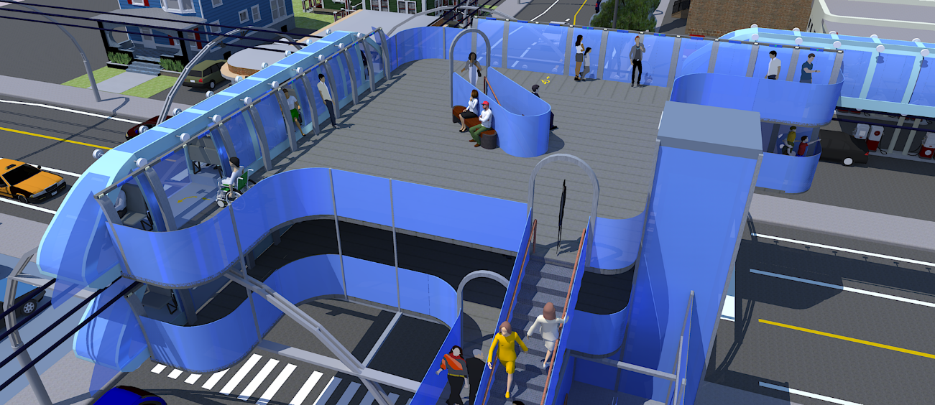
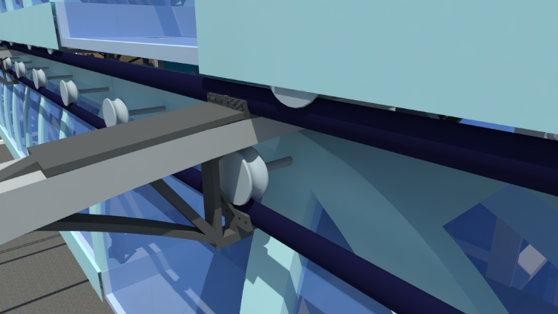
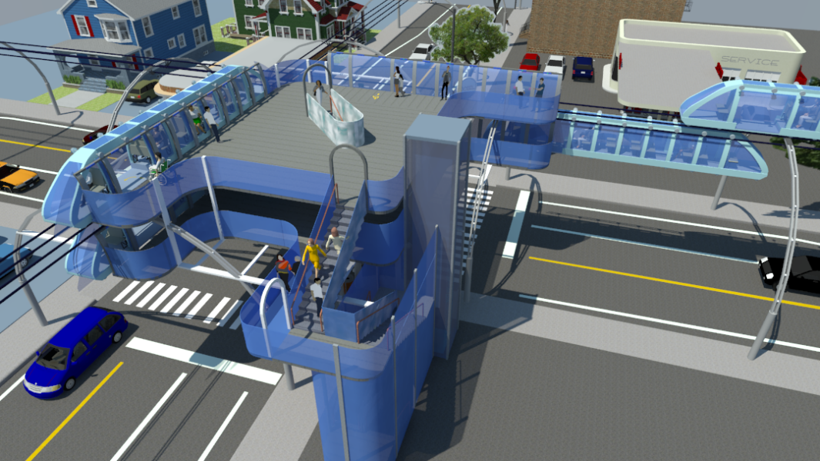
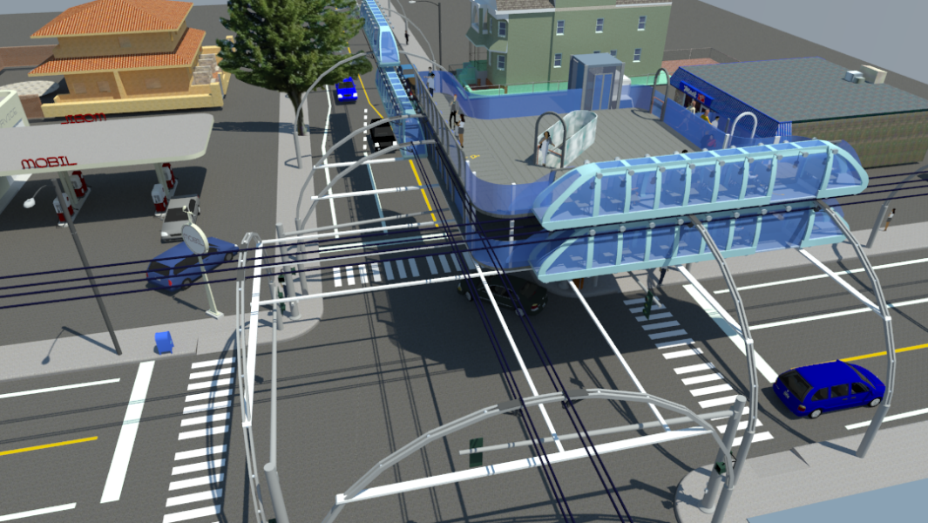
Overview: Intersection of two train lines.
Each line has two directions where one train travels above the tracks in one direction while the other travels below the tracks in the opposite direction. Hence the station has two levels.
Passengers can switch between the two lines via stairs connecting upper and lower floors

Slide 2
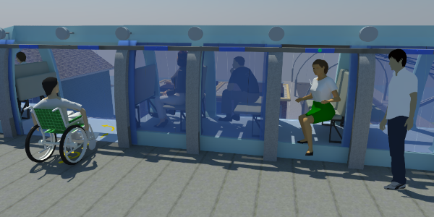
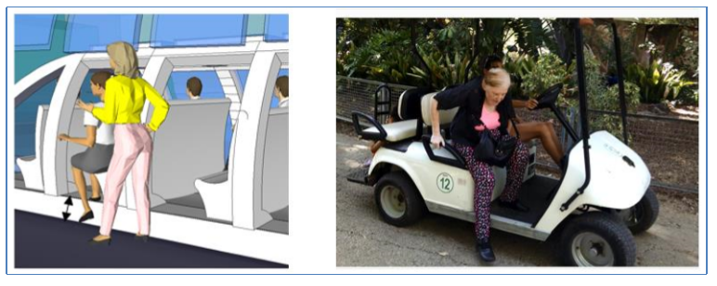
Issue: minimize the time required to spend at each stop & maximize comfort and ease of entry and exit
Solution:
- Height differential (red arrow) between platform and floor of the train allows for quicker and easier exit with less vertical movement needed to sit down and stand up (resembling the entry and exit to to/from an SUV.
In order to reduce the entry and exit time, the floor of the train is elevated above the platform of station. Given the height of the train floor above the station floor there is a reduction in the standing up and sitting down time and effort required for each passenger.
The differential in height of vehicle platform versus ground level makes for easy access, similar to seating into and getting out from an SUV or a golf cart. The image below is from various videos showing that for an older person it takes less than 3 seconds to exit or enter vehicle. Given this preliminary test, and at one passenger per row with a maximum of 3 seconds required for entry and 3 seconds for exit, a stop is not expected to exceed 6 seconds, thus an average of 8 to 10 seconds stop time per station may be a reasonable assumption.

Slide 3
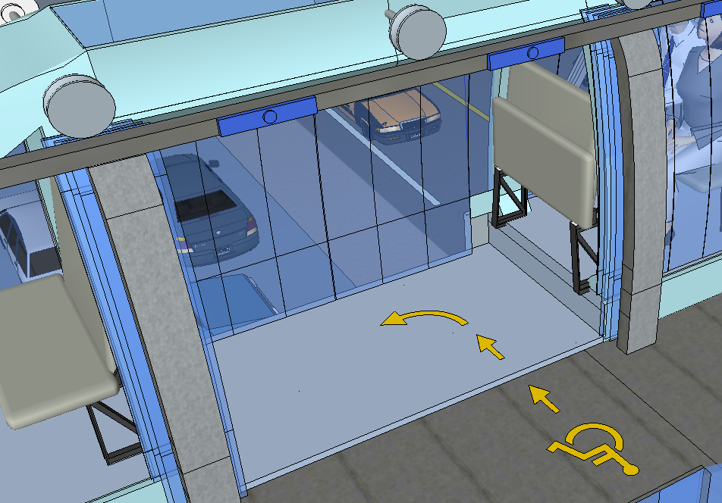
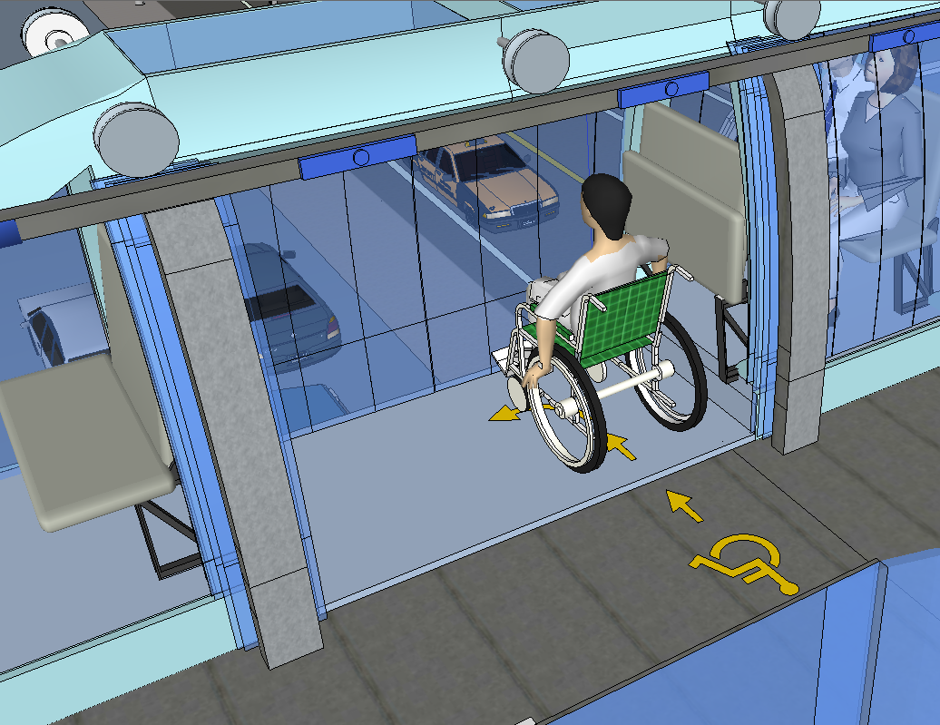
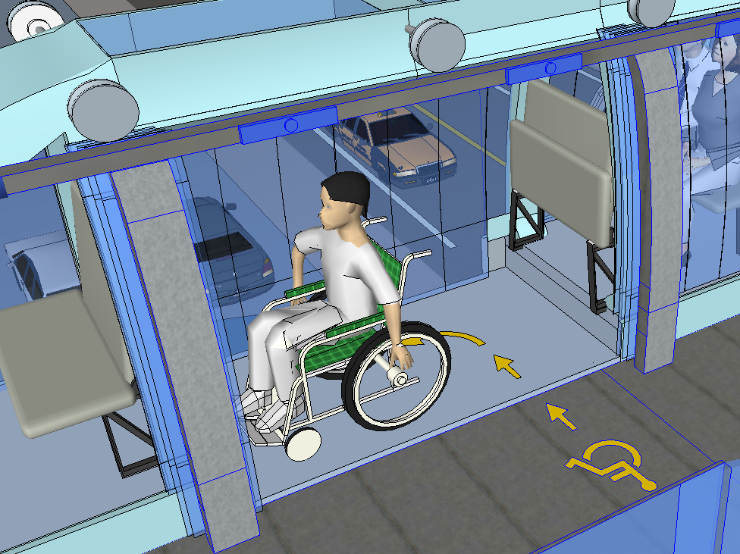
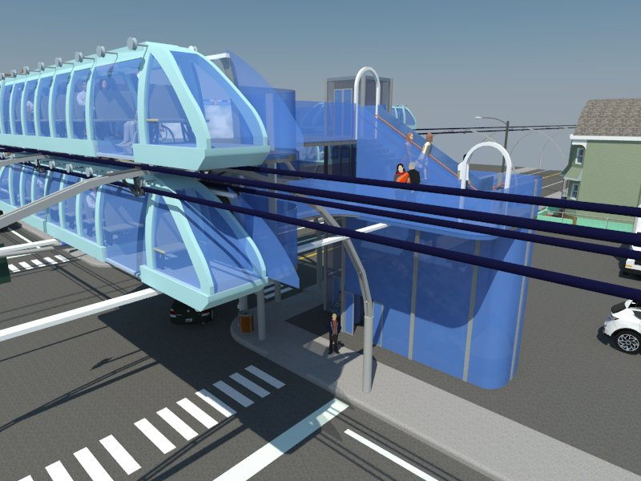
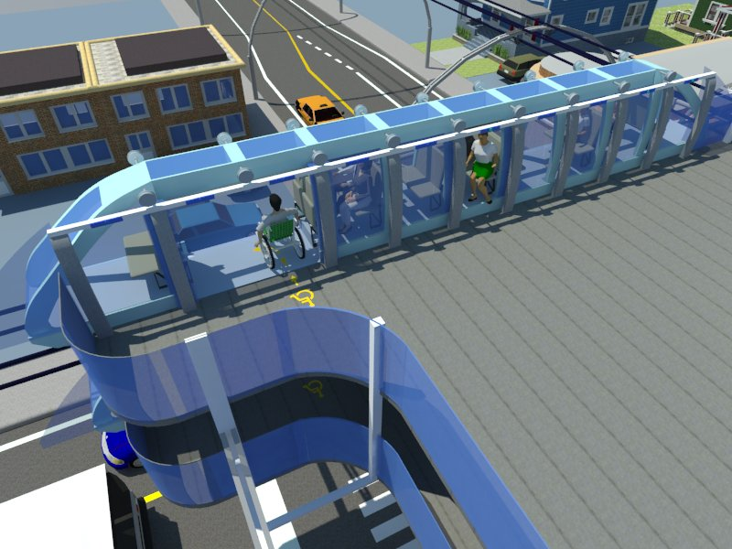
Users of the system: public at large including wheelchair access
Because the train is only 48” wide, wheelchair users will need to follow the yellow arrow if the wheelchair depth is greater than the width of the train

Slide 4
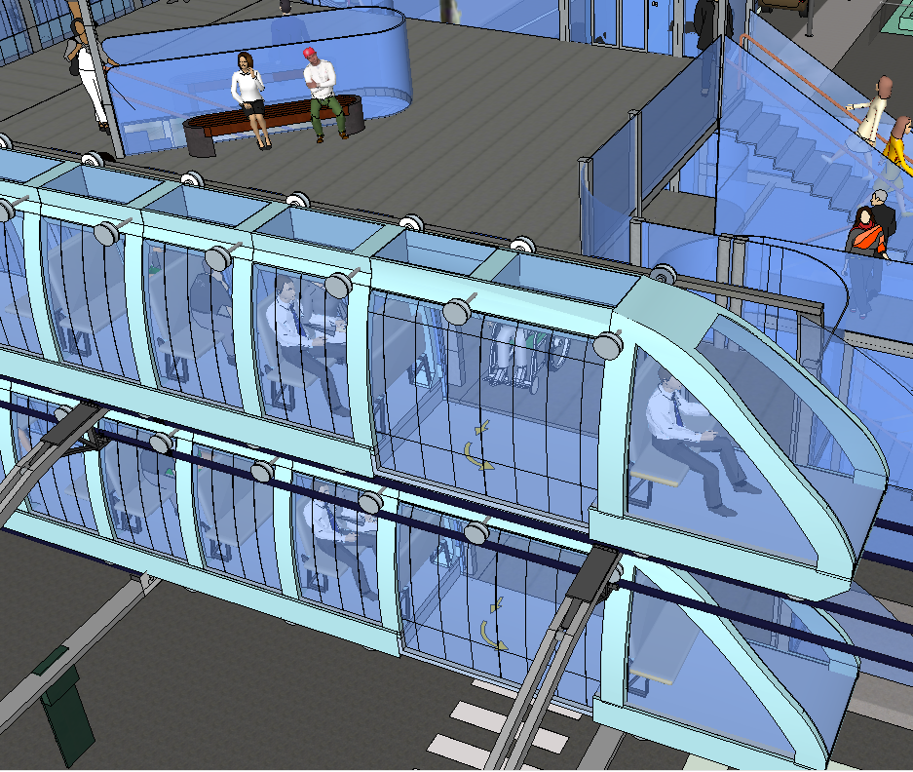
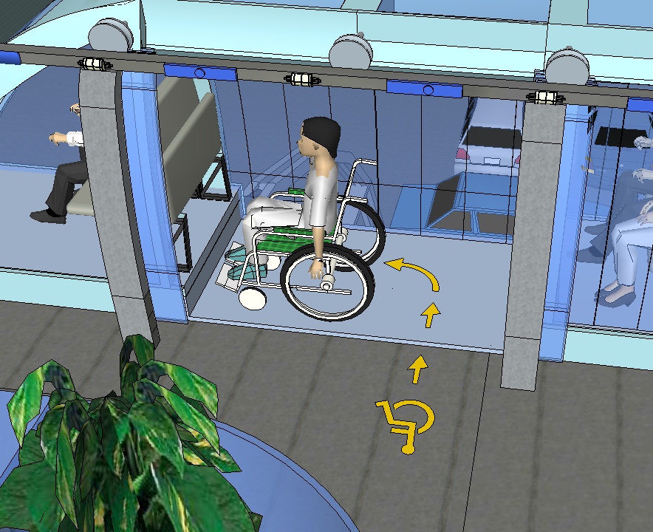
Issue : depth when entering with a wheelchair is less than code – but at a minimum acceptable of 48” “when circumstances prevent compliance. As a way to compensate the wheel chair can turn 90 degrees so it has ample space – 72” lengthwise – as shown by the red dotted line/arrows
ADA CODE: 4.10.9 – Floor Plan of Elevator Cars
The floor area of elevator cars shall provide space for wheelchair users to enter the car, maneuver within reach of the controls, and exit from the car. Acceptable door opening dimensions shall be 36″ (915mm) minimum. Cab depth shall be 51″ (1291mm) minimum with a 54″ (1370mm) minimum from rear of cab to inside face of door. Cab width shall be a minimum of 68″ (1730mm) for side opening doors and an 80″ (2030mm) minimum for center opening doors. When existing circumstances prevent compliance with cab dimensions it must be noted that no dimensions shall be less than 48″ by 48″

Slide 5
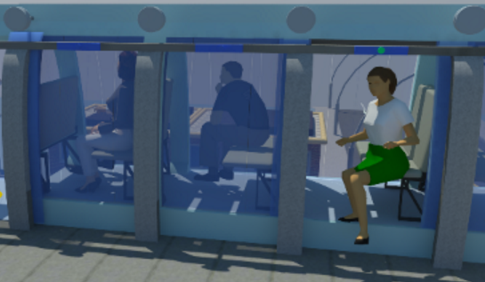
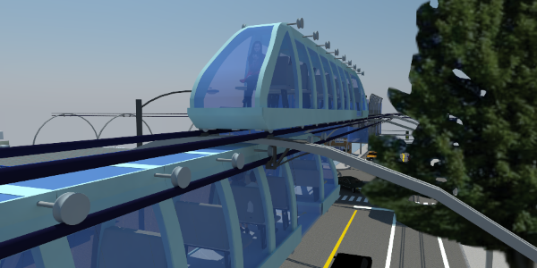
How the space will positively influence the Health, Safety and Wellness for occupants.
Noise Free - the cTrain wheels use rubber on the area of contact
with the tracks which combined with small electric motors produce
no audible noise from street level.
Privacy - Each passenger has a dedicated cabin with sufficient space for suitcases and also the option to share with a significant other.
Comfort - Seating for all – the cTrain provides seating room only
Low stress - access to seats – the cTrain model is design to cover all major streets and avenues at sufficient capacity to accommodate the demand without the need for passengers to compete for seats.
Easy Access to mass transit from all areas - the cTrain concept is designed to cover all areas in a city with stations within 2-3 blocks from any residence or business. This reduces the dependence on cars and adverse health effects of pollution and stress from traffic.
Visually pleasing - open views with abundant light

Slide 6
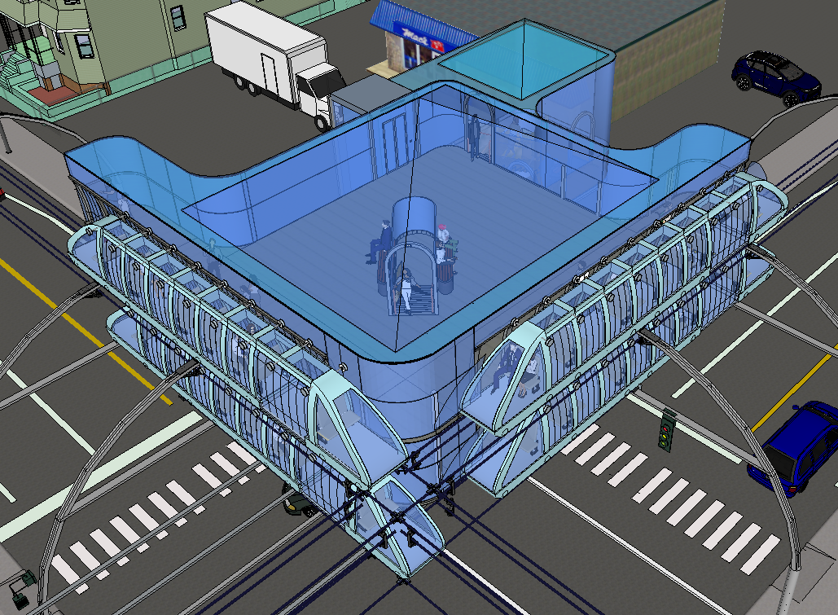
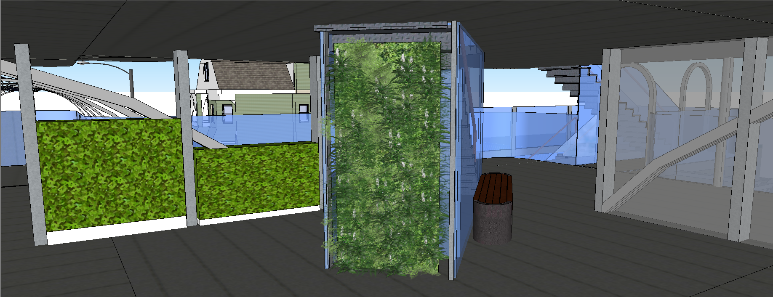
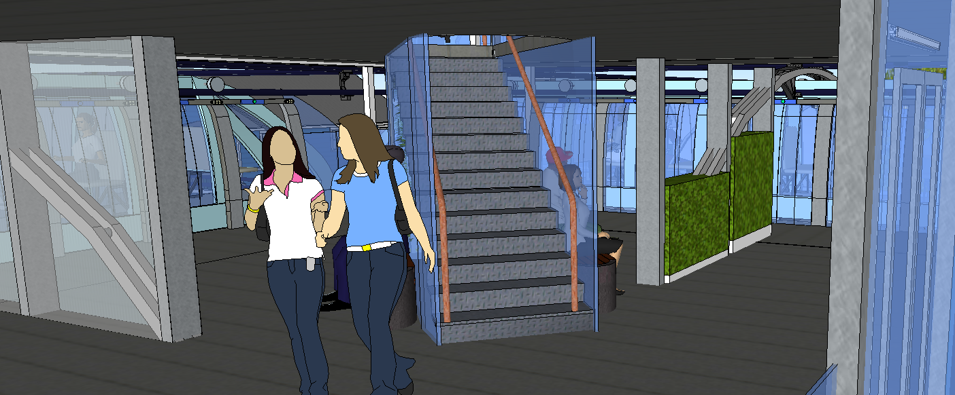
Biophilic design
  Temperatures - for stations in climates where there is need for enclosure there will be elements such as Thermal Airflow with variability between 64 and 70 degrees Fahrenheit,
  Vegetation – inclusion of natural elements such as plants helps induce relaxation, and in this case would help reduce the sense of an artificial environment relative to the typical spaces people are used to. On the first floor vegetation can serve also as a separators from structural elements (such as the supporting arches) and area below stairs. On the right side the arches are separated by glass versus vegetation on the right side.

Slide 7
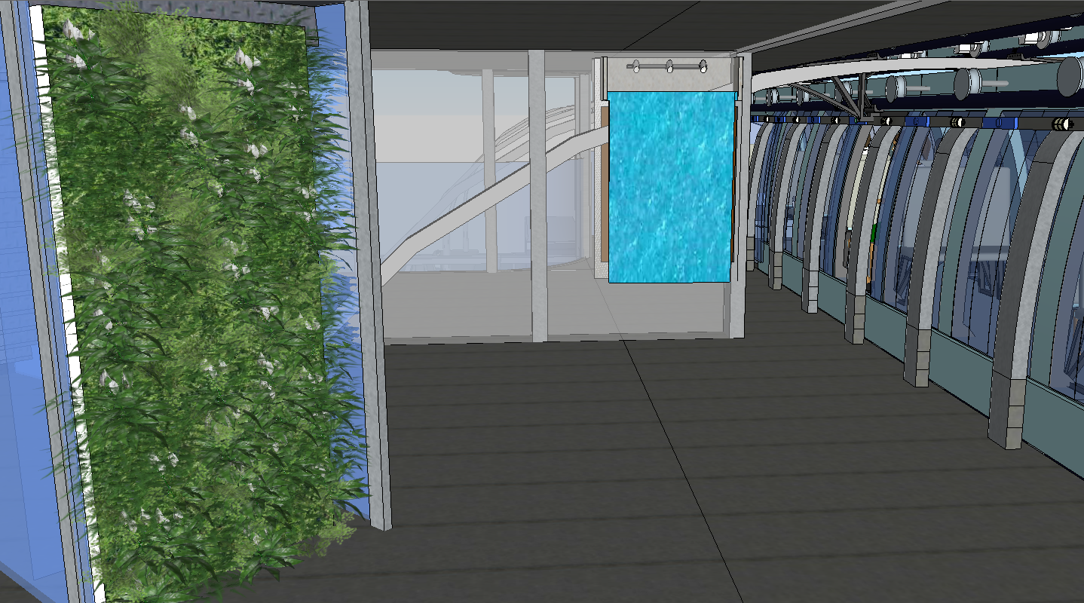
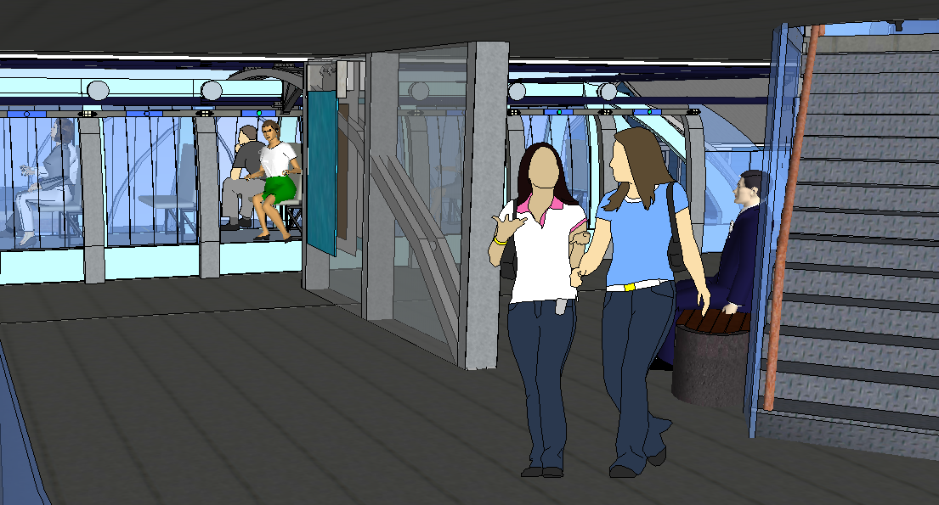
Key elements implemented from Environment and Behavior Theories
Biophilic design
  Water – Presence of flowing water enhances well being.

Slide 8
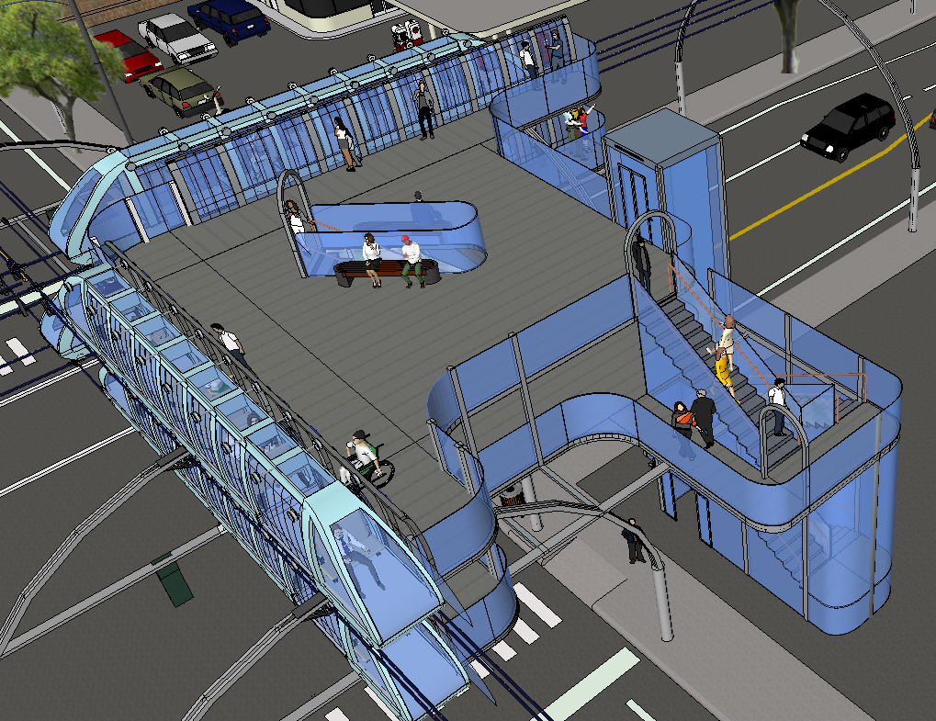
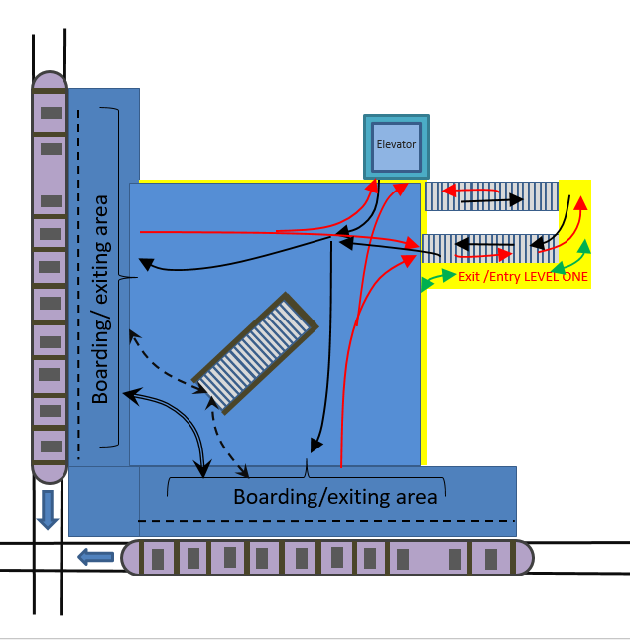
The system will have a wide spectrum of users including those with neurological disorders impacting the relationship of the occupant to the environment in a variety of ways such as perceiving distances, colors, orientation, ability to walk, grasp, as well as their sense of self, of independence.
Points of access between floors, have arches with Exit/Entry signs at the top for easy wayfinding
Use of curvilinear shapes to inspire femininity, nurturing, harmony and warmth – as a way to compensate for the sense of the station being a new imposition upon the visual landscape. The round shapes also can ameliorate the potential of heights and the sense of the station being suspended above traffic, particularly because of wide usage of transparent materials
Circulation optimized for spatial progression, appropriate signage, combined with appropriate color contrast.

Slide 9
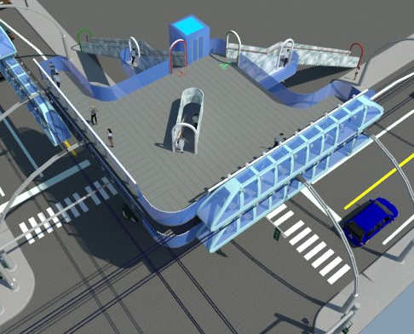
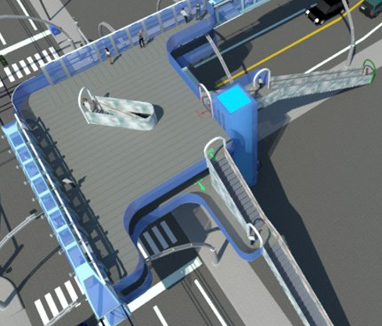
LEVEL 1
CIRCULATION
Passenger exiting a train has three options
A – Switch to a train on the same level
B – Switch to a train on the other level
C – exit the station via the stairs or the elevators
LEVEL 2
Sidewalk
Passengers exiting from LEVEL 2
Passengers Entering to LEVEL 2
Passengers exiting from LEVEL 1
Entry steps LEVEL 1
Passengers Entering to LEVEL 1
Passengers switching to a train on the same level
Landing
WALKWAY TO
LEVEL 1
Entry steps LEVEL 2
Passengers changing to a train on the other level
Steps to/from LEVEL 2
ELEVATOR
Landing
C
Exit STEPS LEVEL 2
Exit STEPS LEVEL 1
Train
Steps to/from LEVEL 2
WALKWAY from LEVEL 1
B
Sidewalk
Platform
A
z
B
C
Train

Slide 10
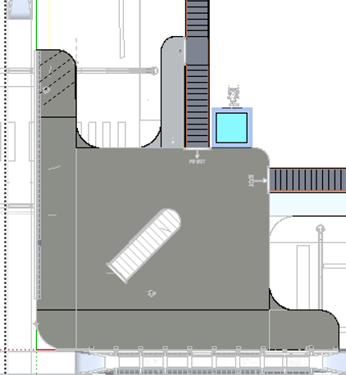
Entry to LEVEL ONE
Entry to LEVEL TWO
Elevator
Exit from LEVEL TWO
Exit from LEVEL ONE
Boarding/ onboarding area
Boarding / onboarding area

Slide 11
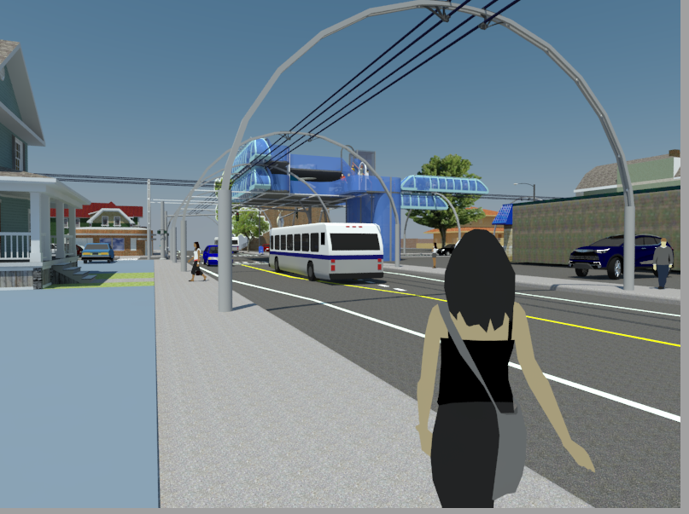

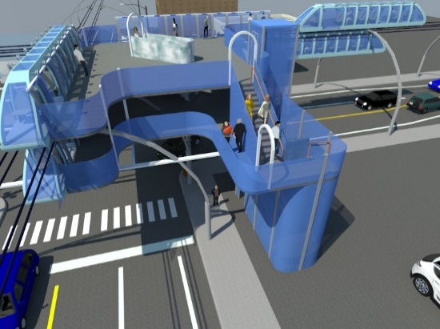
Visual Impact: One of the main challenges with overhead transportation is the visual impact on the urban landscape. To minimize the visual impact the cTrain has the following features
Transparent materials – maximizing the use of transparent materials for both the stations and the trains helps reduce visual impact. Research needed regarding the use of transparent materials combined with metallic skeletons for the supporting arches
Minimal width - only 48” wide
Minimal height – only sufficient height for a passenger to fit in seated position – similar to the height of an SUV
Minimal thickness of supporting structures - the above to features help minimize weight which in turn minimize the thickness needed for the structure the support the tracks
cTrain travels above and below the same set of tracks in order to keep it as far away as possible from either side of the sidewalks (as shown by the two arrows)

